Slide 1

Gold price Forecasting
TEAM MEMBERS –
* ABHISHEK KUSHWAHA
* SHUBHAM GEETE
* LAKSHMIKANT MOHAPATRA
* JYOTI GUPTA
* THOTE HARSHAL
* MADIGA POORNA CHANDRA
* YOGESH FULARI

Slide 2

AGENDA
DATA DESCRIPTION
DATA ANALYSIS
CONCLUSION

Slide 3
Work Flow :
So we will divide our work flow into following 3 steps.
Data Collection
and
understanding
Data Cleaning
and
Manipulation
Exploratory
Data
Analysis(EDA)

Slide 4
Data Collection and Understanding:
After collecting data its very important to understand your data. So we has Gold Price Forecasting data. Which has rows 2182 and 1 columns . So lets understand this 1 columns.

Slide 5
EDA
Part

Slide 6

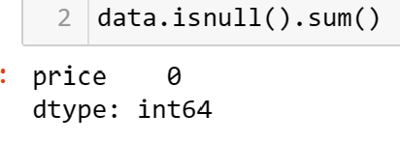
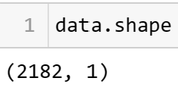
Text the data understanding and cheaking missing/null values
Checking the null values in dataset
Checking the duplicate values
Checking the size of dataset

Slide 7
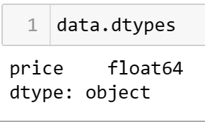
Data-type
Unique rating values
From above analysis, we can say that there are no null
values .
- 1- duplicate value in our dataset..

Slide 8
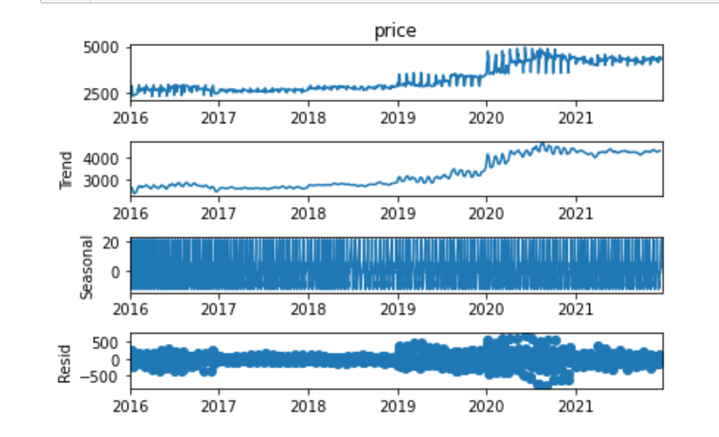
Decompose plot :- Decomposition helps us to better analyze the data and exploring different ways to solve the problem. that involves breaking down Time Series data into many components or identifying seasonality and trend from a series of data.

Slide 9

AD Fuller Test :-
From above visual,we can say that almost the dataset is non-stationary.
We have an unequal and imbalanced dataset.

Slide 10
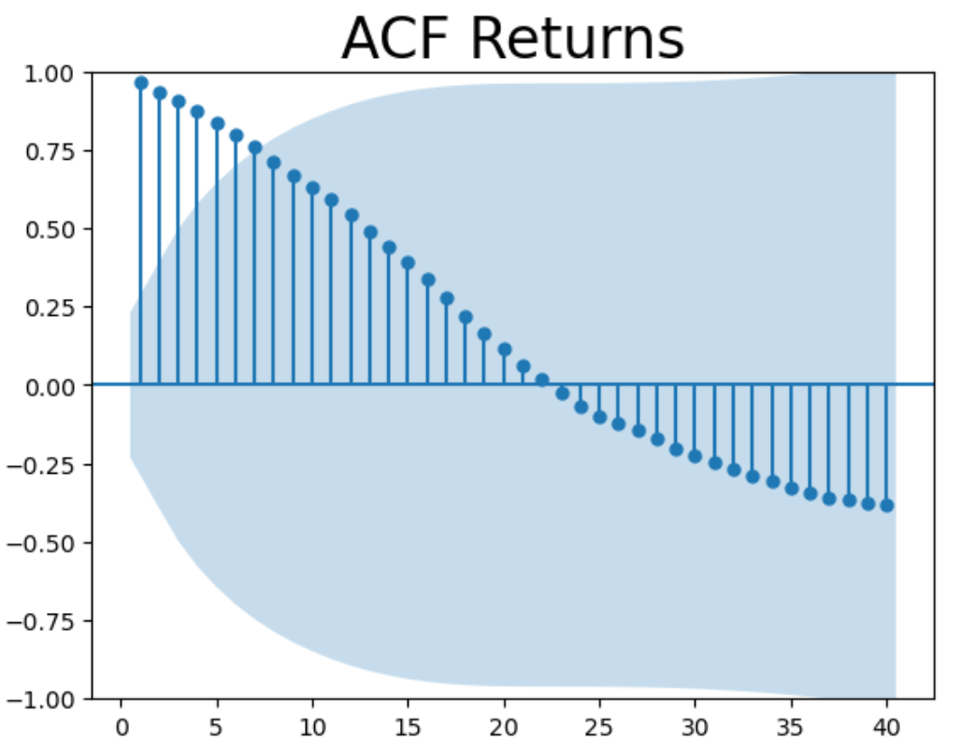
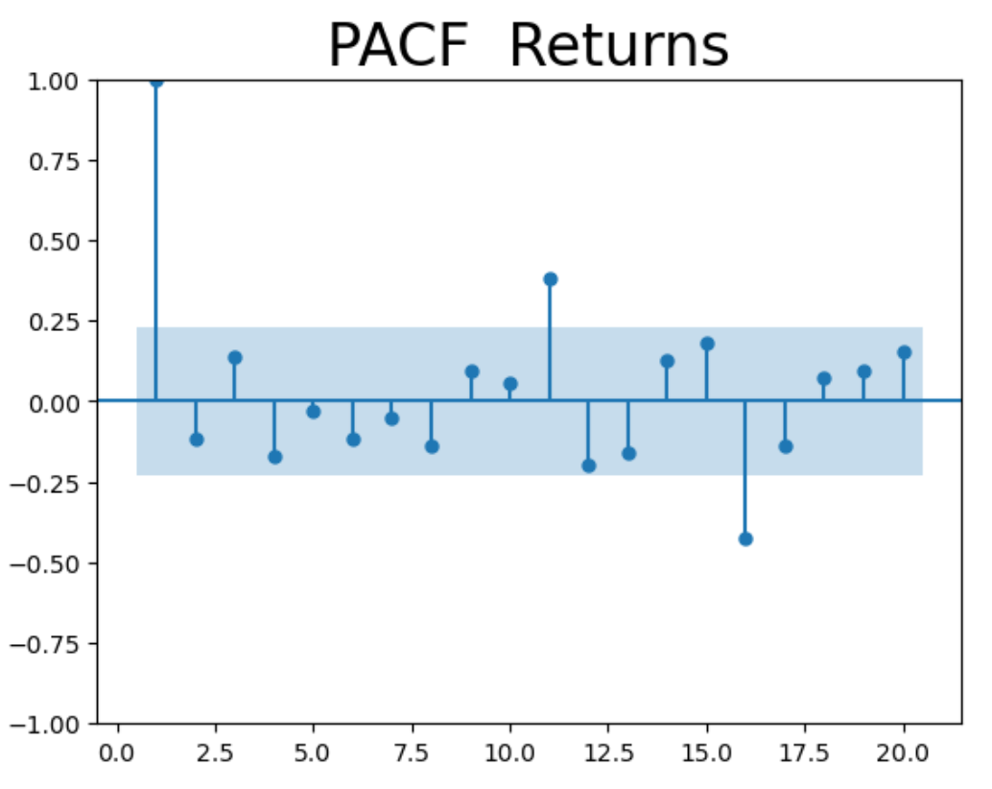
ACF and PACF :-

Slide 11
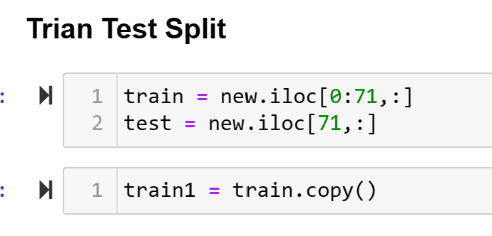
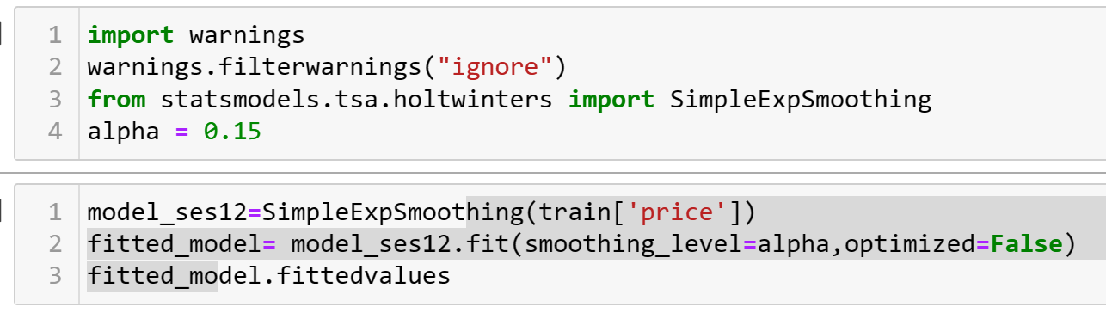
Model Building :
Simple Exponential Smoothing :

Slide 12
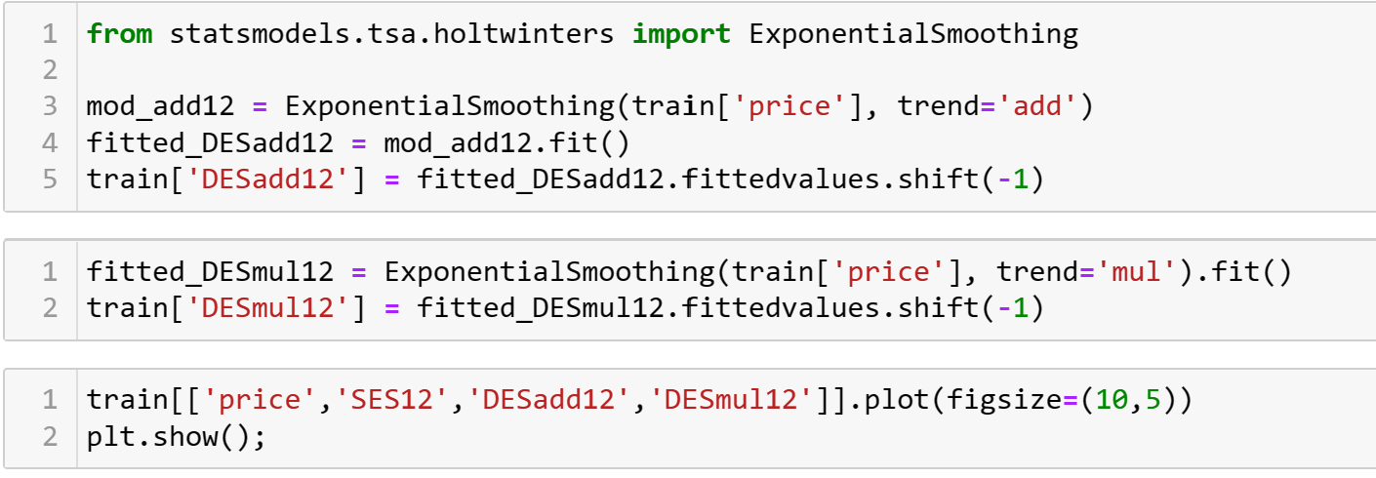
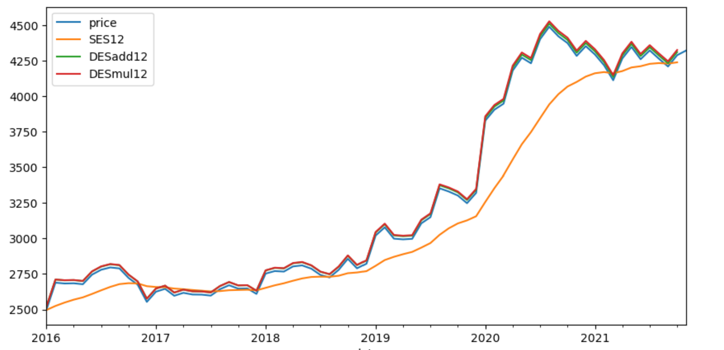
Double Exponential Smoothing :

Slide 13
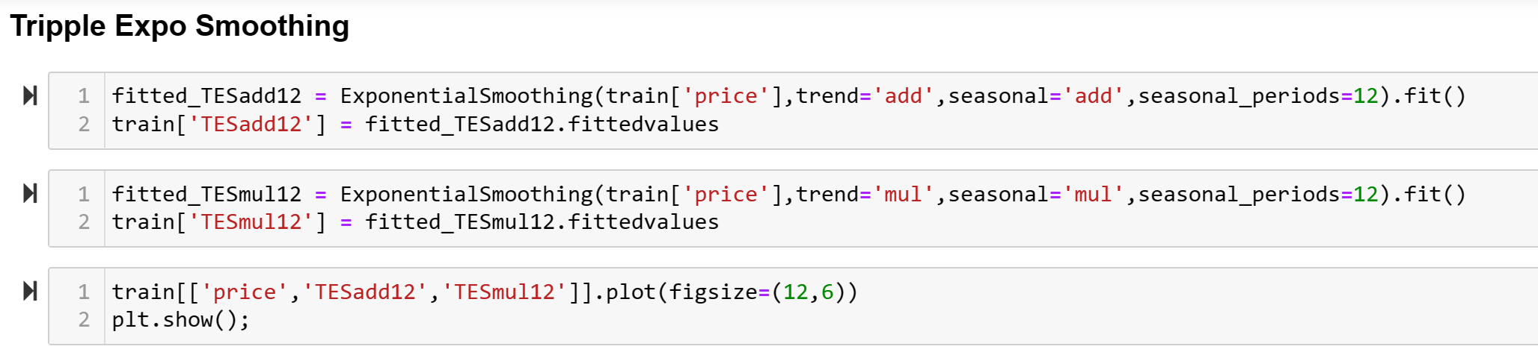
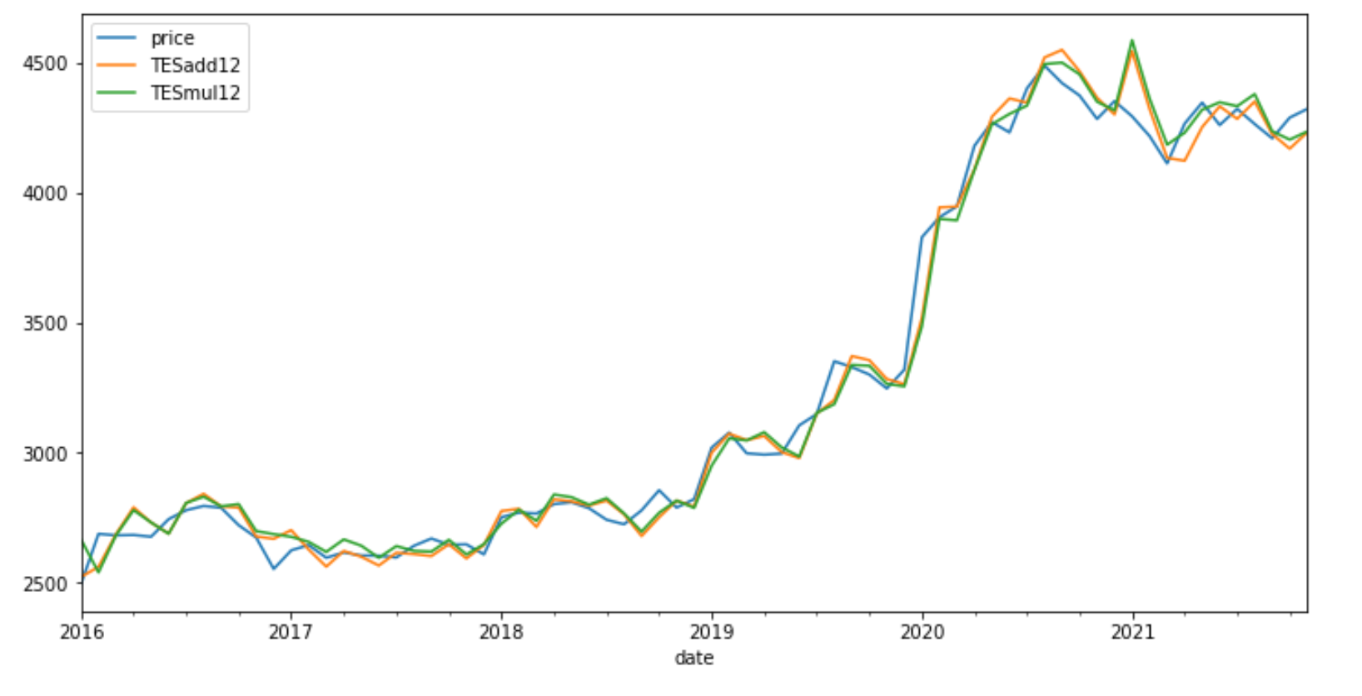
Triple Exponential Smoothing

Slide 14
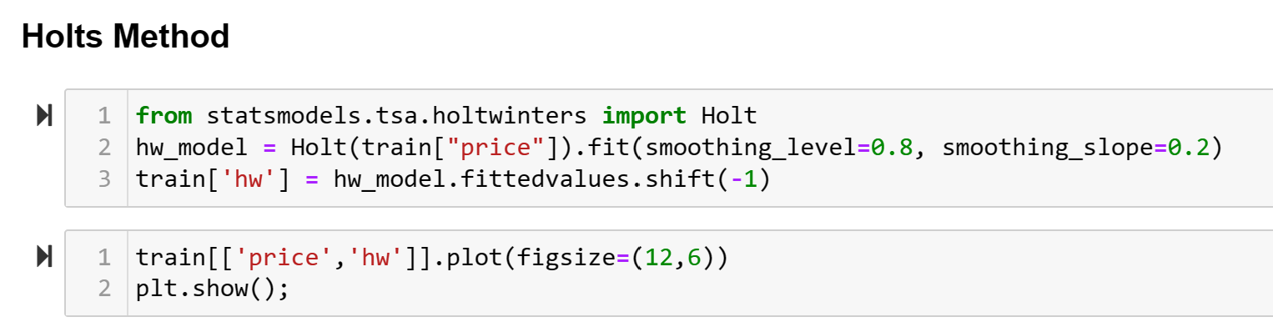
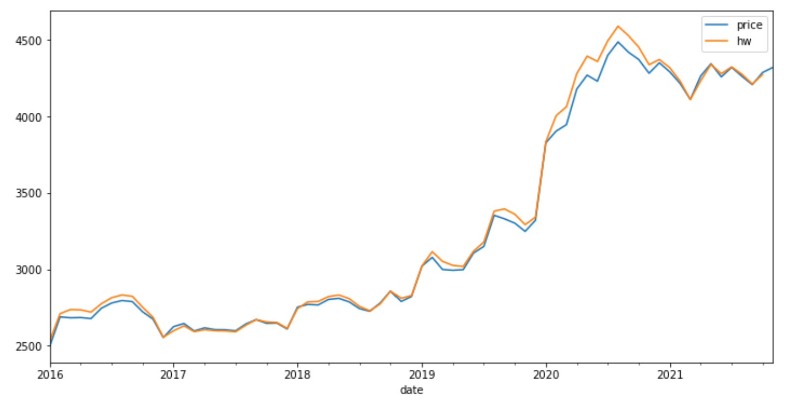
Holts’s Method :

Slide 15
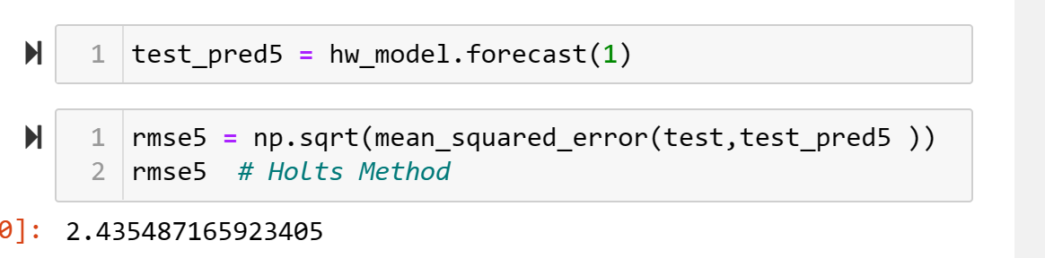
Holt’s Model Evaluation :

Slide 16
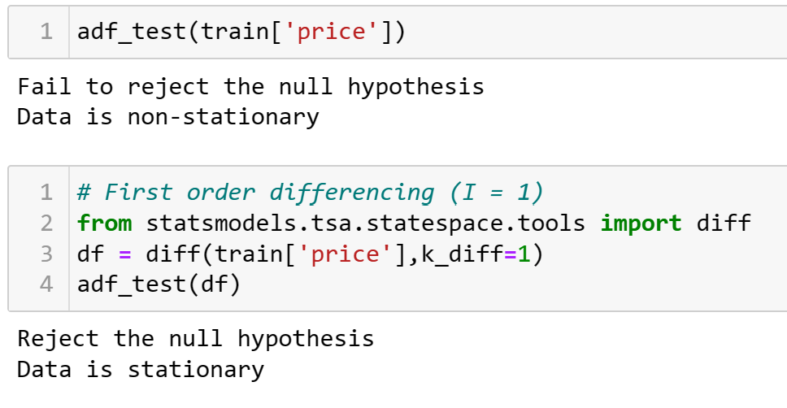
Auto Regression Model :

Slide 17
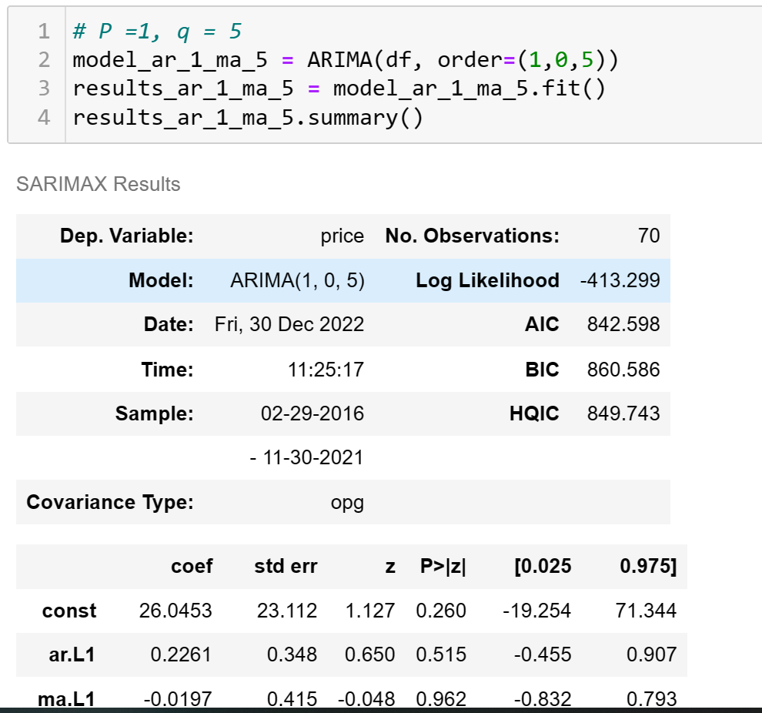
ARIMA Model :

Slide 18
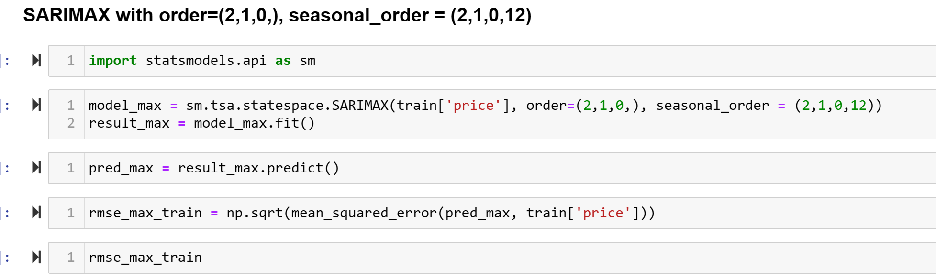
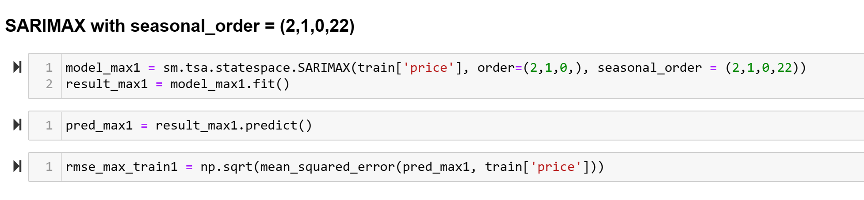
SERIMAX Model :

Slide 19
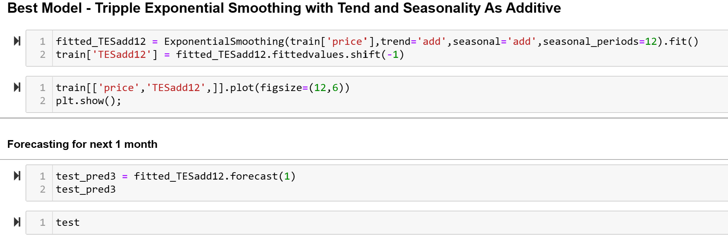
Best Model : - Triple Exponential Smoothing with
Tend and Seasonality As Additive

Slide 20
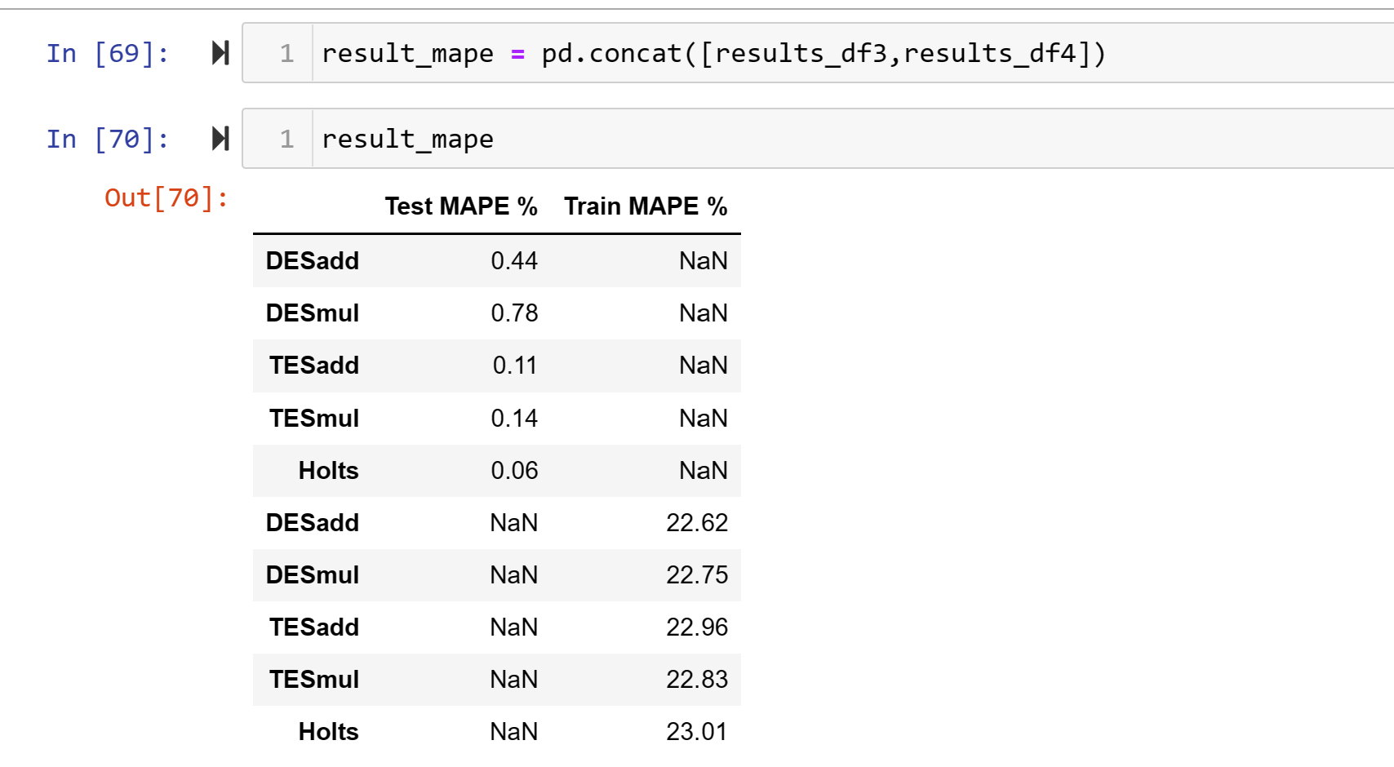
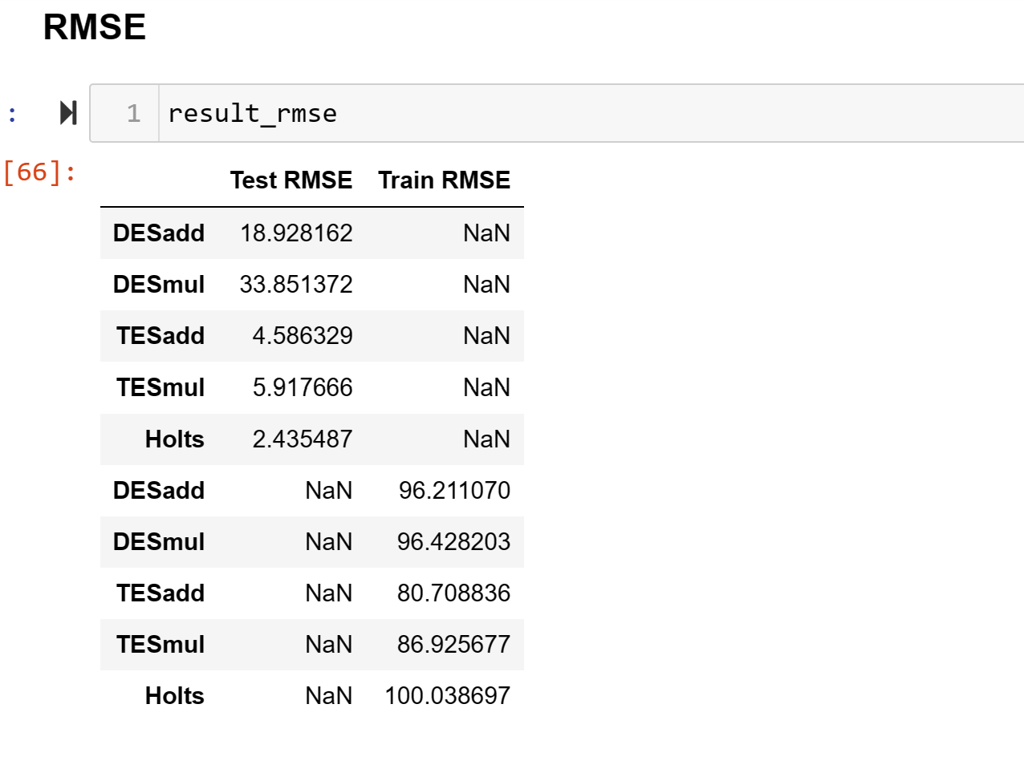
RMSE /(Root Mean Square Error) - It measures the average difference between values predicted by a model and the actual values.

Slide 21
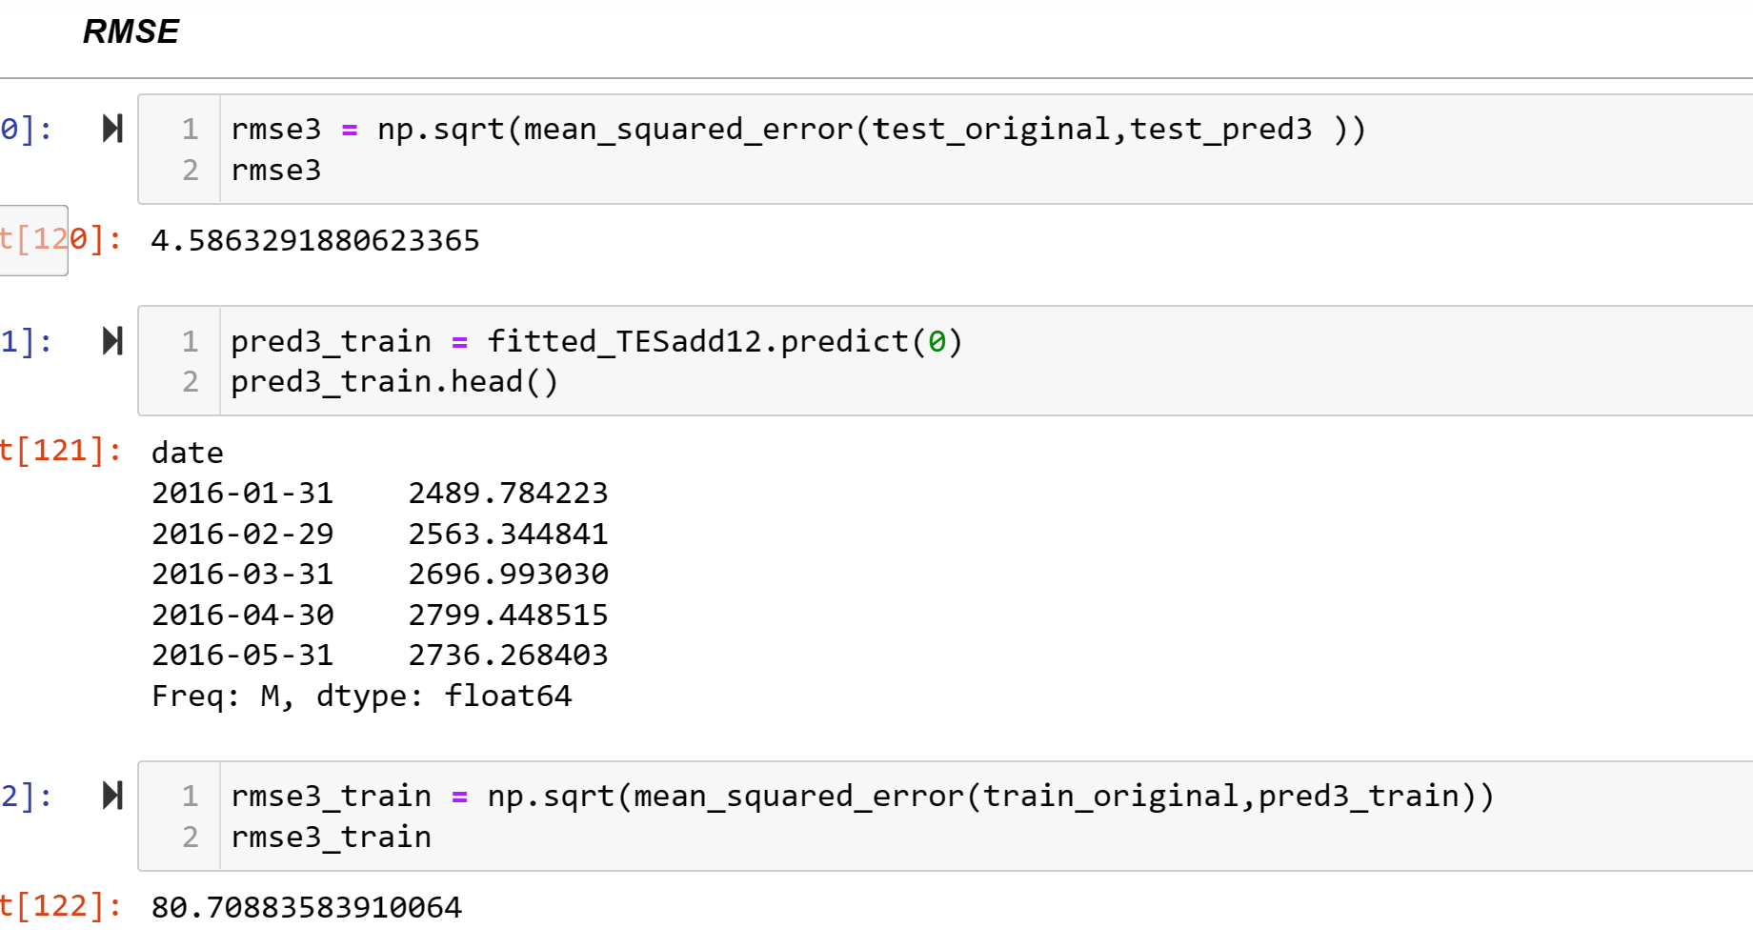
RMSE OF BEST MODEL – Triple Exponential Smoothing with Tend and Seasonality As Additive

Slide 22
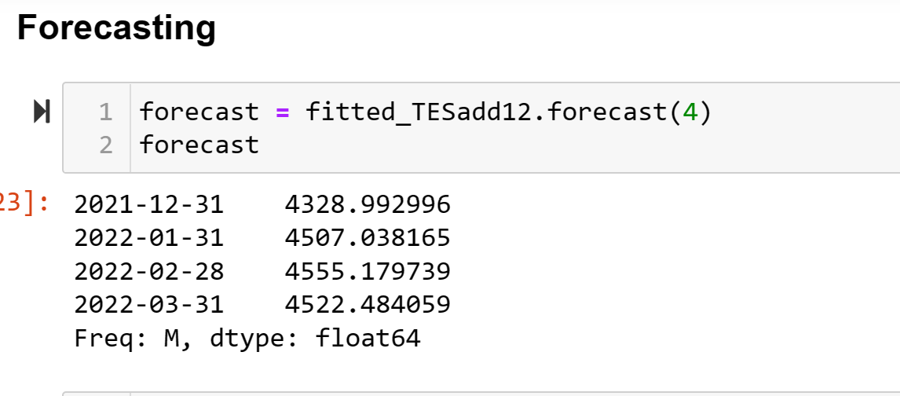
Forecasting -

Slide 23
Thank you – TEAM EXCELR Thanks very much for the assistance you provide our project. we sincerely appreciate it.

